Slide 1


Web graphics Three.js
By Amr Fayez

Slide 2
01
Introduction
02
Project Structure
03
Lighting & Materials
04
Coordination system
05
Textures
06
Animation Loop

Slide 3
07
3D Model Loaders
08
AEC Editor
0
You can describe the topic of the section here
You can describe the topic of the section here

Slide 4

About me
Senior Fullstack
Amro Fayez
01068987680

Slide 5
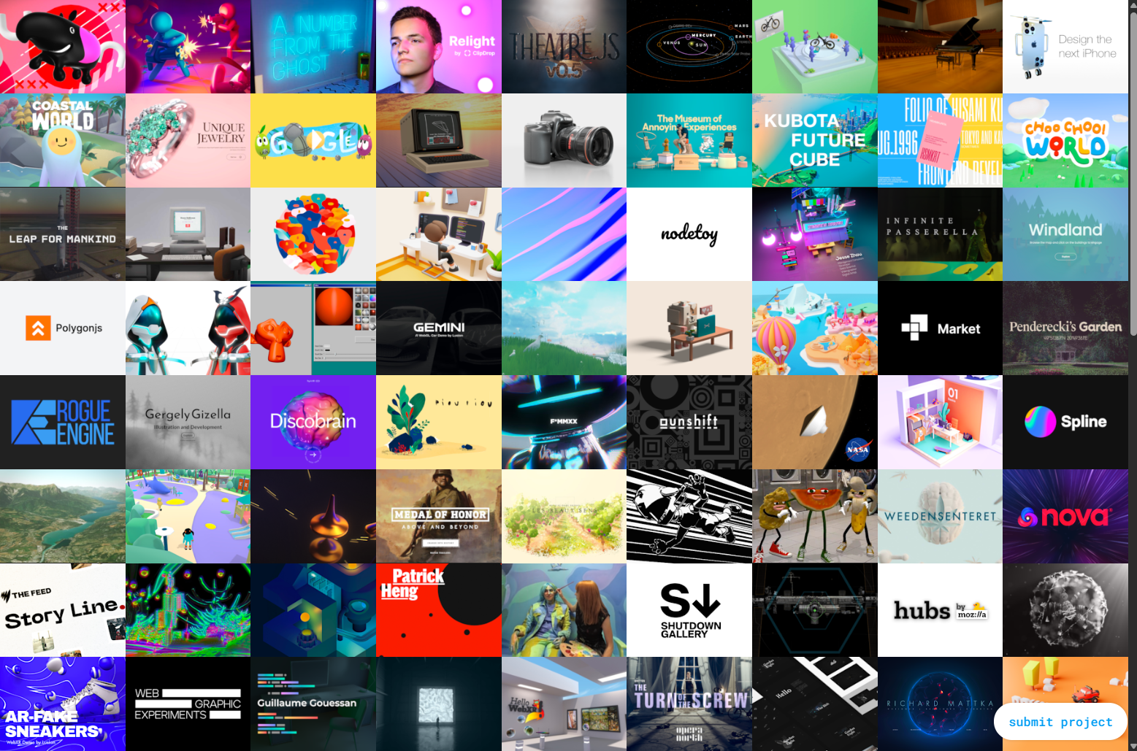
Introduction

Slide 6
Installation

Slide 7
Resources
https://discoverthreejs.com/book/
https://threejs.org/docs/
https://threejs.org/editor/
https://learnopengl.com/Getting-started/Coordinate-Systems

Slide 8
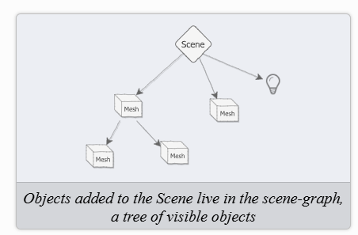
The Scene: a Tiny Universe
The scene is a holder for everything we can see.

Slide 9
The Camera
Think of your 3D scene as a movie set, and the camera in Three.js as the film camera. It determines:
Where you are standing (position)
Where you're looking (direction)
What part of the scene is visible (field of view)
There are several ways to convert the scene graphic into a human vision friendly format, using techniques called projections.

Slide 10
The Camera
Perspective Camera
like the human eye (objects farther away appear smaller)
Orthographic Camera
like architectural drawings (objects stay the same size no matter how far they are)

Slide 11
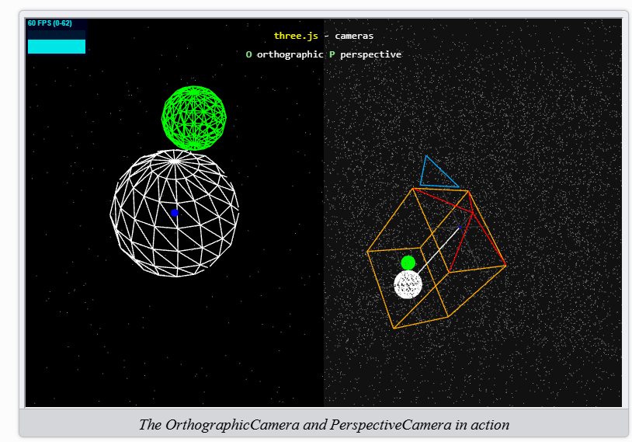
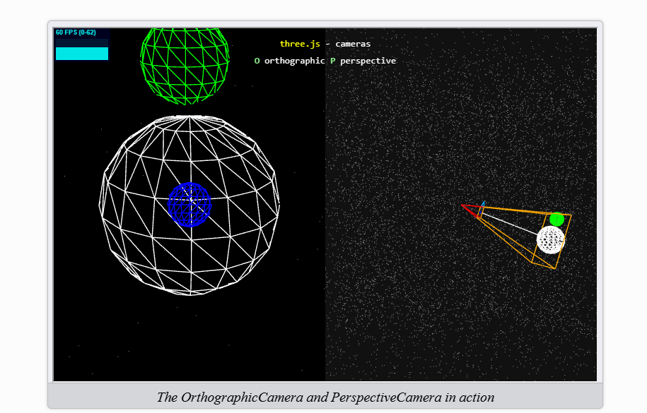


Orthographic Camera
Perspective Camera

Slide 12
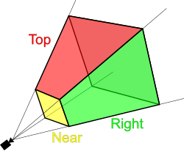
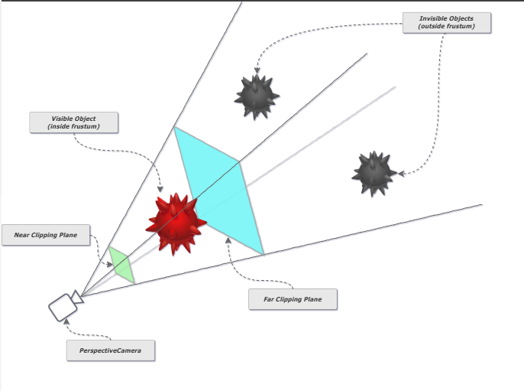












The Camera
Viewing Frustum

Slide 13
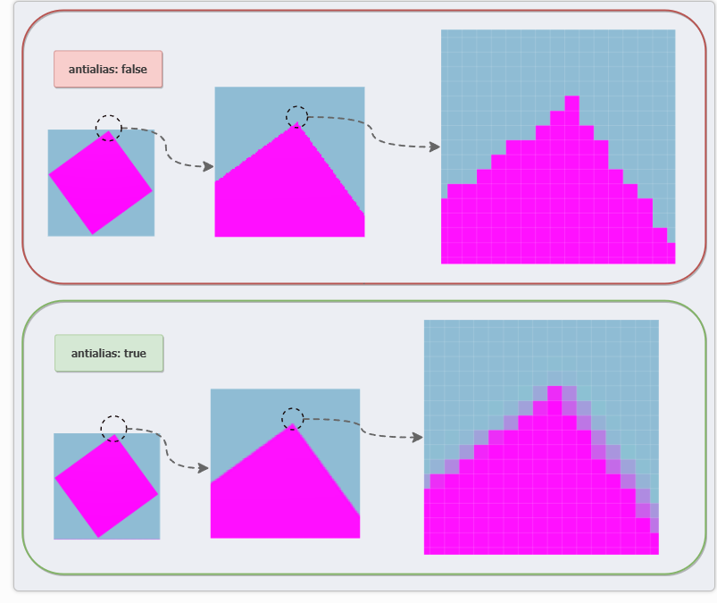
Renderer

Slide 14









device PixelRatio
devicePixelRatio values other than 1 render the scene at a higher or low resolution and then scale it to fit in the canvas. A DPR of 2 will render the scene at double resolution and scale down, while a DPR of 0.5 will render at half resolution and scale up. As you can imagine, high DPR values are very expensive to render!

Slide 15
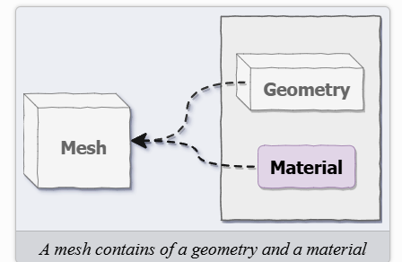
Our First Visible Object: Mesh
A mesh is a 3D object you see in a scene.
It is made of two parts:
Geometry – the shape (like a cube, sphere, etc.)
Material – the appearance (color, texture, transparency)
🧩 Think of it like:
Geometry = mold or skeleton
Material = skin or surface appearance
Together, they form the visible 3D object we render.

Slide 16
Geometry
Geometry Class | Description
BoxGeometry | Cube or rectangular box
SphereGeometry | Sphere
PlaneGeometry | Flat 2D surface
TorusGeometry | Donut shape
CylinderGeometry | Cylinder
BoxGeometry | Cube or rectangular box
SphereGeometry | Sphere
PlaneGeometry | Flat 2D surface
TorusGeometry | Donut shape
CylinderGeometry | Cylinder

Slide 17
Exercise 01
Easy
Change the color of the scene background. You can enter any standard color name such as red, green, purple, and so on, as well as some unusual names like aquamarine or coral. How many of the 140 CSS color names can you guess?
Medium
Change the cube to some other shapes like a rectangle, sphere, triangle, or torus. (Hint: search the docs for “BufferGeometry”.)
Add a second cube and move it around using mesh.position.set(x, y, z) (you’ll either need to figure out some way of returning two cubes from the createCube function, or add a second module like cube2.js).
Hard
Add a button to the HTML page, and delay rendering the scene until the button has been clicked. Do this without making any changes to the World app. Instead, create the button in index.html and set it up in main.js.

Slide 18
Materials
What Are Materials?
Materials define how a 3D surface responds to light and rendering settings — including color, reflectivity, transparency, shading style, and texture usage.
Imagine a cup made of different materials:
Glass → transparent, reflective.
Plastic → smooth and opaque.
Metal → shiny, reflective.
Wood → matte and textured.

Slide 19




Material
Material Type | Description
MeshBasicMaterial | No lighting, always flat color/texture
MeshStandardMaterial | Responds to light, realistic
MeshPhongMaterial | Shiny with highlights
MeshLambertMaterial | Matte finish, responds to light
BoxGeometry | Cube or rectangular box
SphereGeometry | Sphere
PlaneGeometry | Flat 2D surface
TorusGeometry | Donut shape
CylinderGeometry | Cylinder

Slide 20
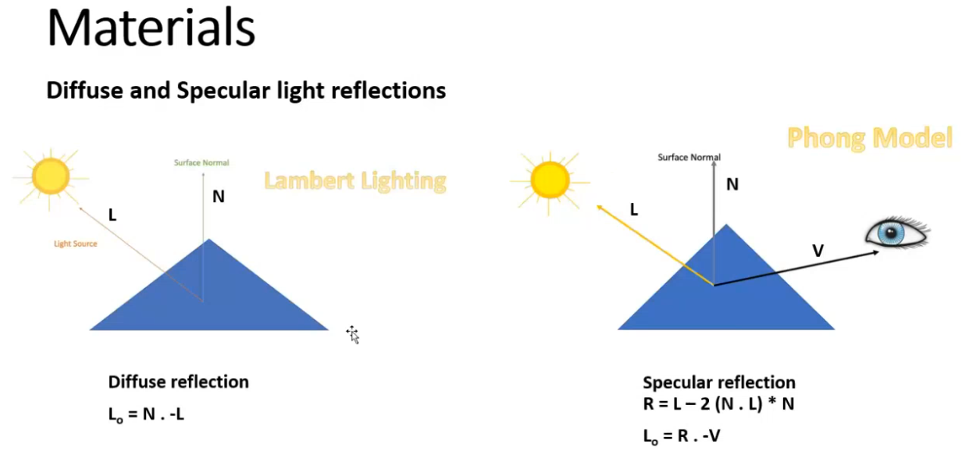

Slide 21
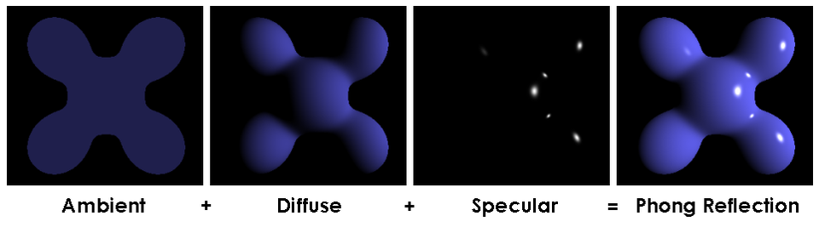

Phong Model

Slide 22
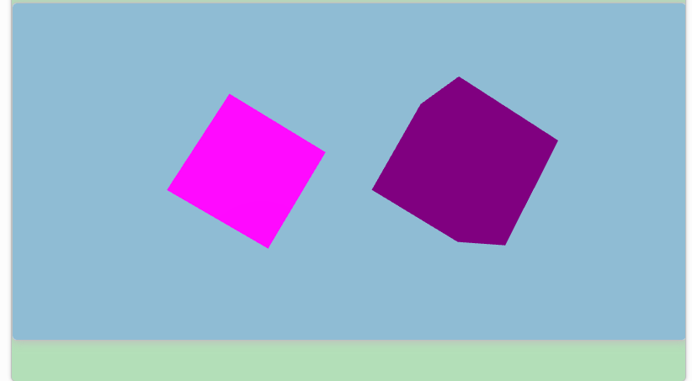
Materials
MeshStandardMaterial vs MeshBasicMaterial

Slide 23
Lighting
Just like in the real world, lighting in 3D graphics determines how we see objects. It affects the appearance of objects by:
Casting shadows
Illuminating surfaces
Creating highlights
Without lighting, your 3D scene would be completely dark, no matter how many objects you add.

Slide 24
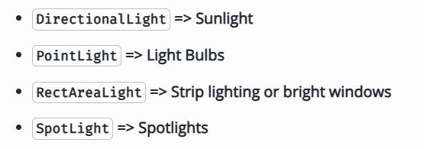
Lighting
🌟 Types of Lights
There are several types of lights in Three.js, and each affects the scene differently:
Ambient Light – general, soft lighting that doesn't have a specific direction (affects everything uniformly).
Point Light – like a light bulb, emits light in all directions.
Directional Light – like the sun, casts parallel light in a specific direction.
Spotlight – like a stage spotlight, shines in a cone shape.
Hemisphere Light – combines a sky color and a ground color, typically for outdoor scenes.

Slide 25
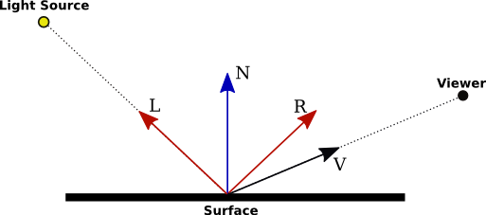


Slide 26
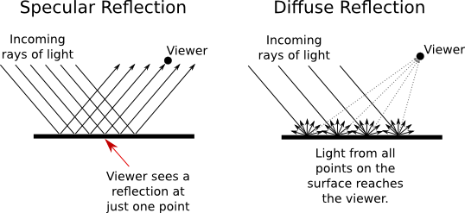


Slide 27
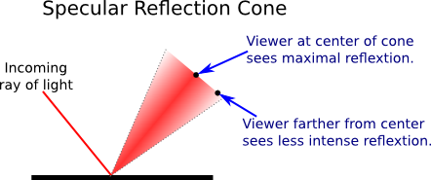

Notes:
https://math.hws.edu/graphicsbook/c4/s1.html

Slide 28
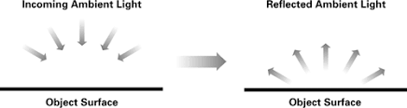
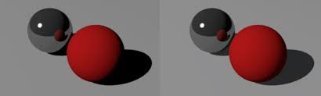
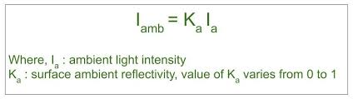
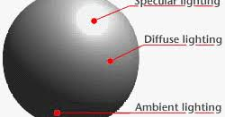
Ambient Light

Slide 29
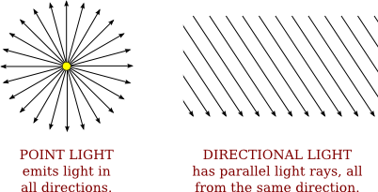



Lights Properties

Slide 30

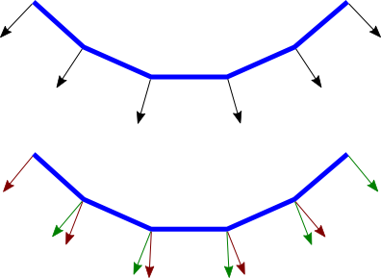


Notes:
The two ways of assigning normal vectors are called flat shading and smooth shading.

Slide 31
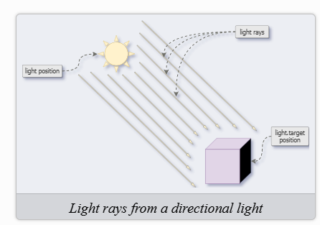
Directional Light
https://threejs.org/docs/scenes/material-browser.html#MeshStandardMaterial
The Material Base Class
Lighting and Depth

Slide 32
Shadow
renderer.shadowMap.enabled = true;
directionalLight.castShadow = true;
mesh.castShadow = true; // For objects that cast shadows
mesh.receiveShadow = true; // For objects that receive shadows

Slide 33
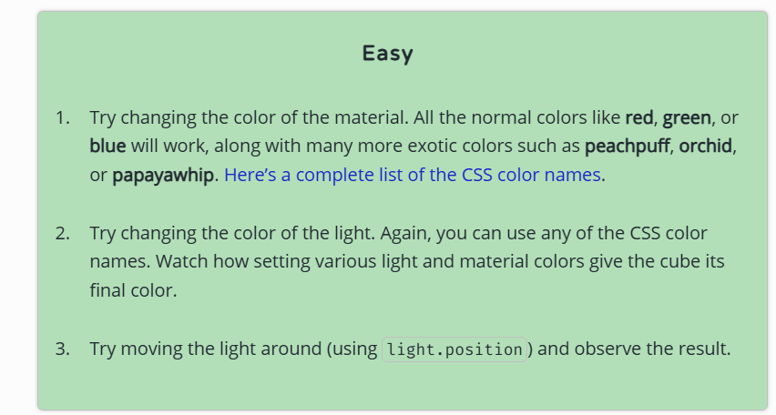
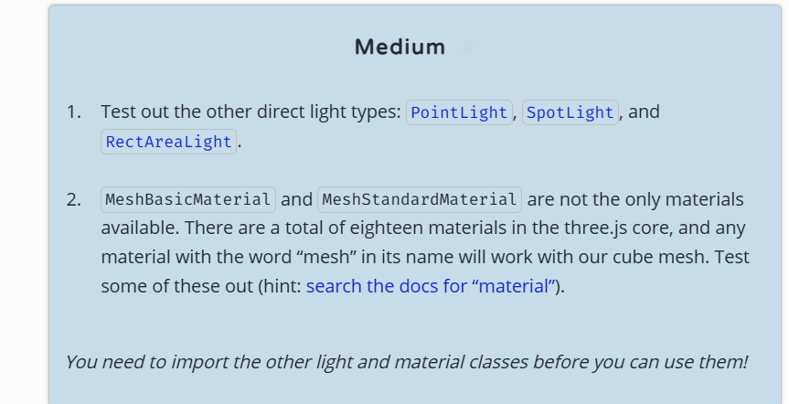
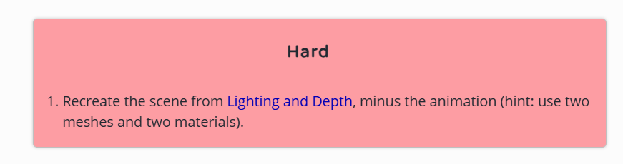

Slide 34
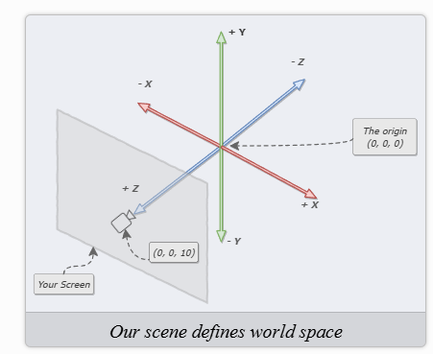
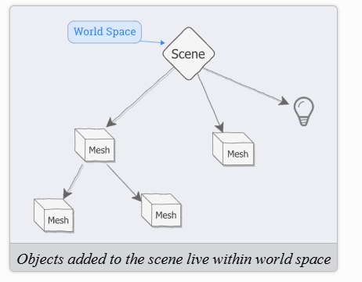







Slide 35
Translation

Slide 36
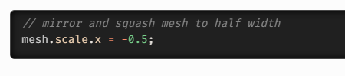
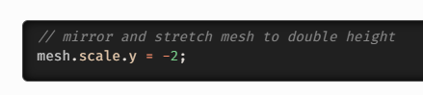
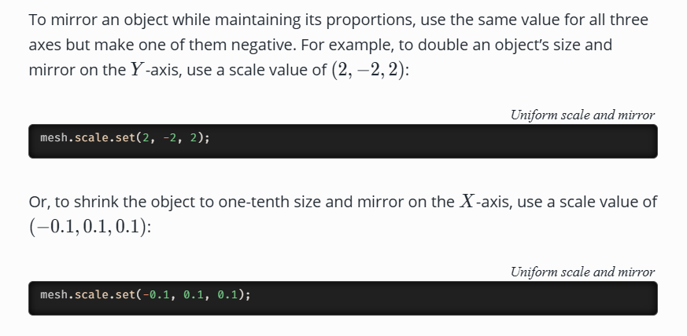
Scaling
Uniform Scaling: Use the Same Value for all Three Axes
Non-Uniform Scaling: Different Scale Values on Each Axis
Negative Scale Values Mirror an Object
Values less than zero and greater than −1 will mirror and squash the object:
Values less than −1 will mirror and stretch the object
Uniform Scale and Mirror

Slide 37
Rotation
the order of rotation matters.
Representing Rotations: the Euler class
Euler Rotation Order
The default order is called ‘XYZ’, but ‘YZX’, ‘ZXY’, ‘XZY’, ‘YXZ’ and ‘ZYX’ are also possible.
The Unit of Rotation is Radians
MathUtils.degToRad(90)

Slide 38
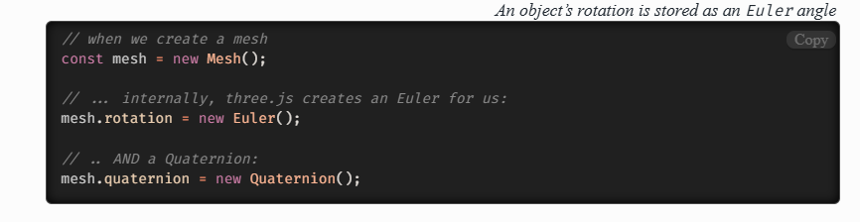
The Other Rotation Class: Quaternions
We can use quaternions and Euler angles interchangeably.

Slide 39
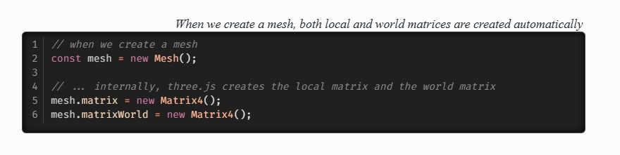
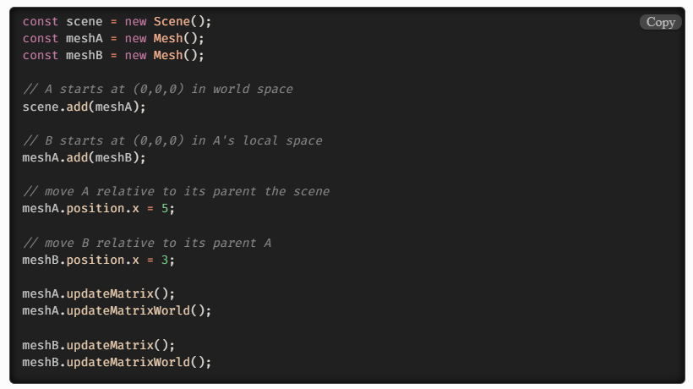
Transformation Matrices
The Local Matrix

Slide 40
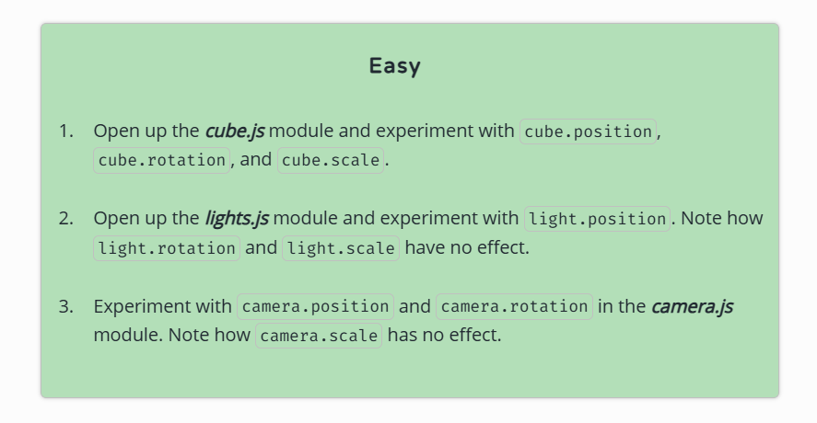
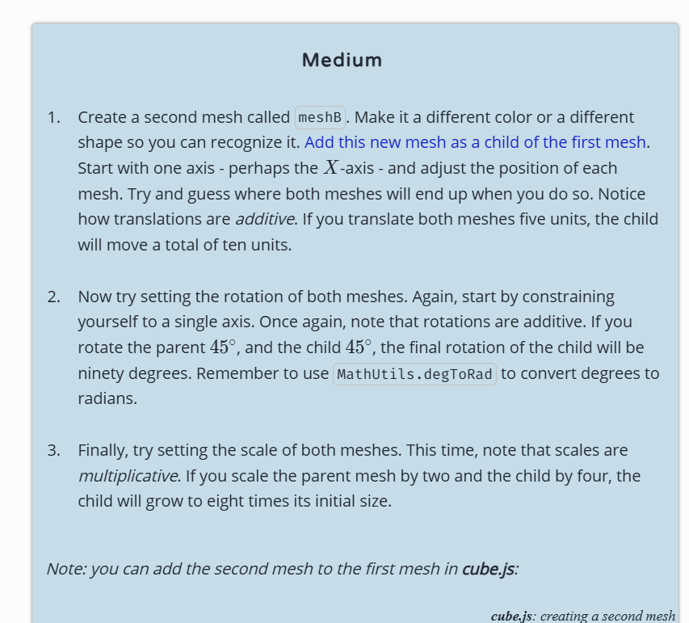
Exercise 03

Slide 41
Bundlers
Webpack
vite

Slide 42
Texture Adding Surface Details
surface detail to 3D models without needing more geometry.
In 3D graphics, highly detailed surfaces (like wrinkles, bricks, or fabric texture)
require a lot of geometry—unless you fake it with textures.
These maps create the illusion of detail or physically deform the surface using grayscale or RGB images.

Slide 43
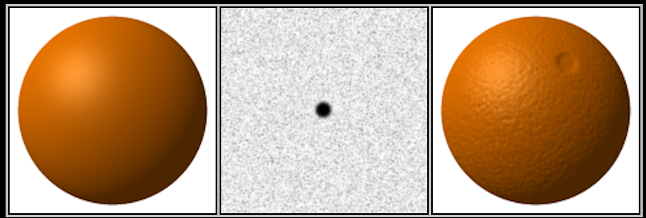
Bump Map
Notes:
Fakes surface height using a grayscale texture—light areas are higher, dark areas are lower—but does not actually change geometry.
How It Works:
Three.js adjusts how light interacts with the surface based on pixel brightness.

Slide 44


Slide 45

Normal Map
Simulates small surface details by altering how light reflects
Notes:
How It Works:
Each pixel’s RGB value changes how the surface appears to face light—like giving fake bumps and dents—with better quality than bump maps.
What It Does:
Simulates small surface details by altering how light reflects, using an RGB texture that encodes surface angles.

Slide 46


Slide 47
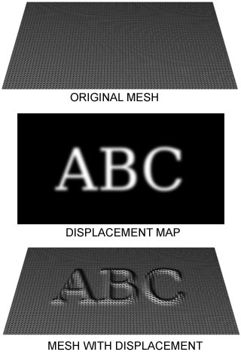
Displacement Map
Notes:
What It Does:
Actually moves vertices of the mesh up/down based on a grayscale map. This modifies the geometry of the surface.
📦 How It Works:
White = high, black = low. More geometry = better detail.

Slide 48
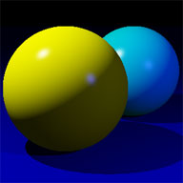

Specular maps
Notes:
A specular map controls how shiny or reflective each part of a surface is. It’s often used in older materials like MeshPhongMaterial.
White areas → strong specular reflection (shiny)
Black areas → dull or no reflection

Slide 49
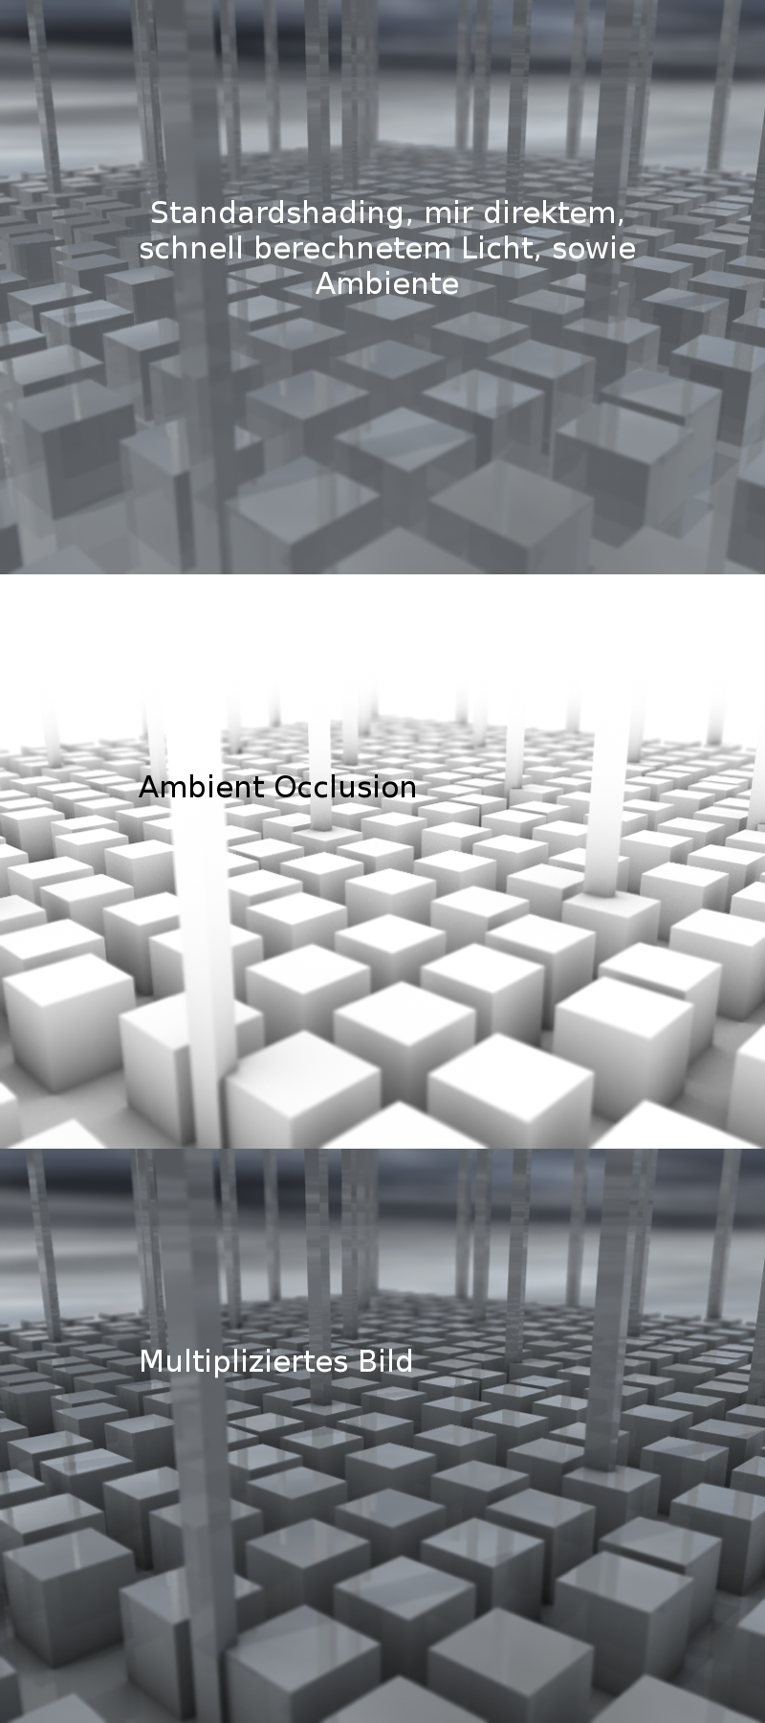
Ambient Occlusion (AO) Map
https://en.wikipedia.org/wiki/Ambient_occlusion#/media/File:AmbientOcclusion_German.jpg
Notes:
In 3D computer graphics, modeling, and animation, ambient occlusion is a shading and rendering technique used to calculate how exposed each point in a scene is to ambient lighting.

Slide 50
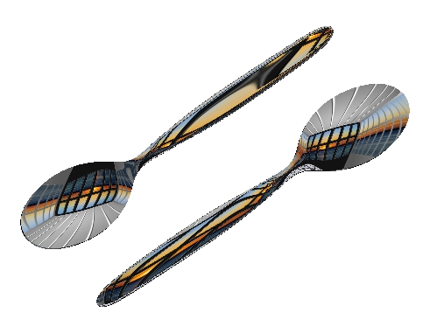

Reflection Maps
Notes:
https://en.wikipedia.org/wiki/Reflection_mapping
An environment map simulates how the environment reflects off an object — even if the environment isn’t fully rendered around the object.
Used for mirror-like materials (metal, chrome, glass, water

Slide 51
Break

Slide 52
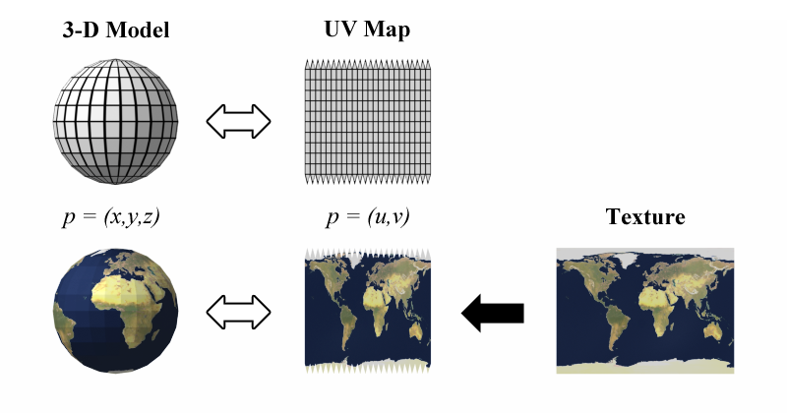
UV mapping

Slide 53
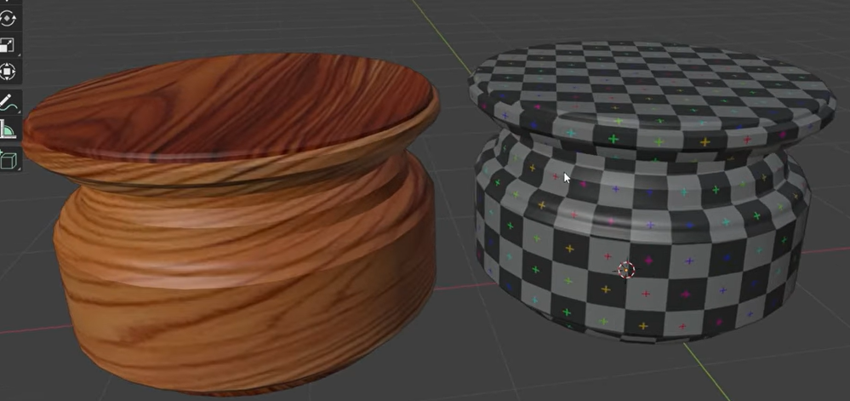

Slide 54
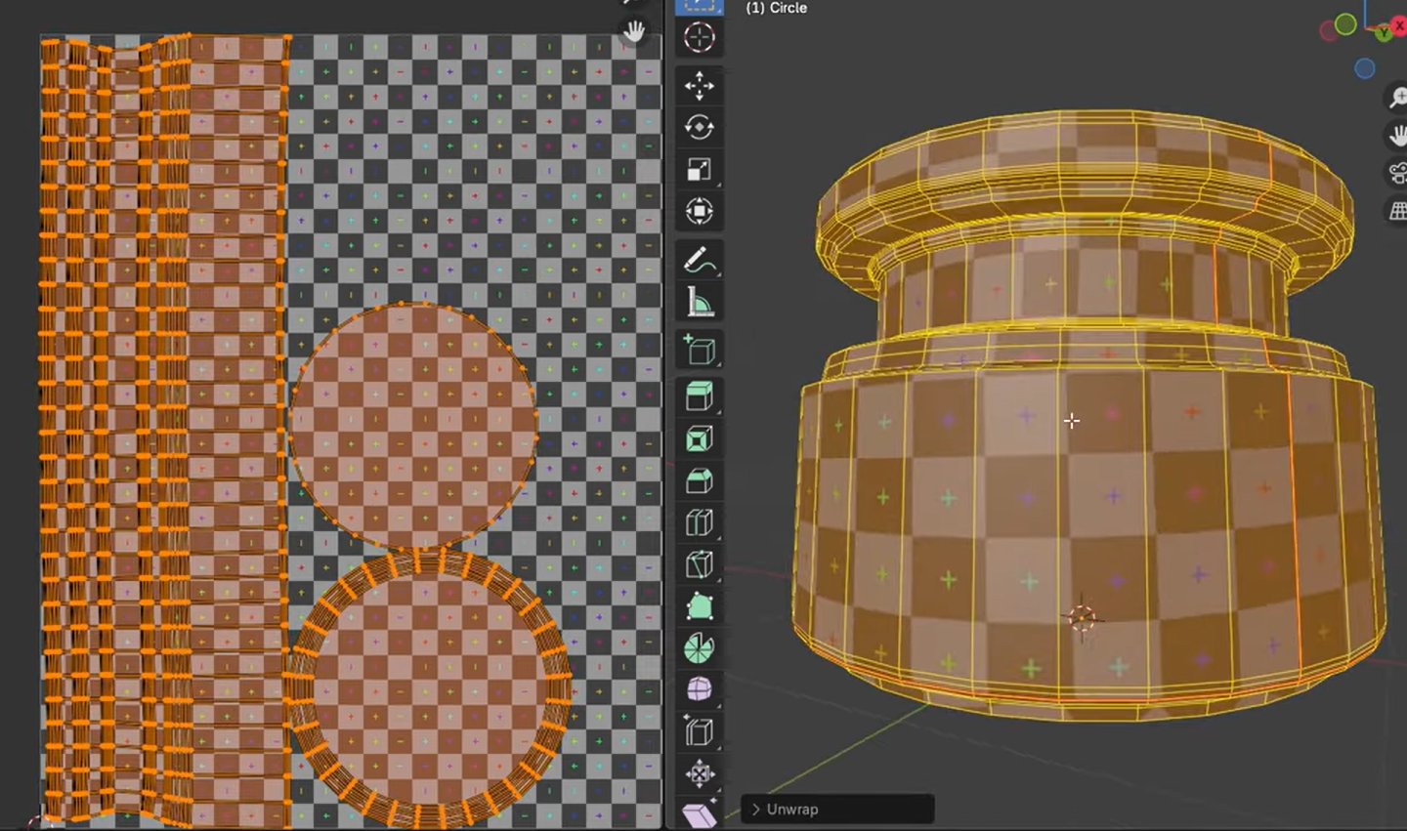

Slide 55
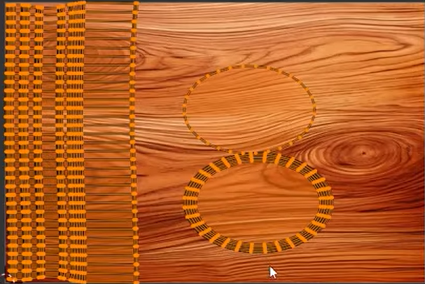
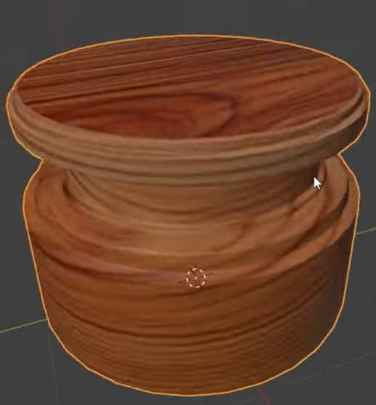
https://www.youtube.com/watch?v=J7iZd6mv7VA

Slide 56
Animation Loop
https://discoverthreejs.com/book/first-steps/animation-loop/

Slide 57
Gen AI Applications

Slide 58
Demo & Applications
Editor
Ai Assistant
German chatbot
Dynamic Dashboard (Natural Language to SQL)
Study field Questionnaire

Slide 59
Purpose of this session
Implement AI assistant to your application
Add simple functionality using AI

Slide 60
Generative AI Applications
AI NOW
With ChatGPT (and all similar generative AI tools that followed), AI has entered an age of mass adoption
AI is now used to create content, not just to automate tasks
AI is now used to (attempt to) "understand" content, not just to process data
AI is now used to generate brand new content, not just to recommend or slightly modify existing content
Most of the contented related to AI Gen application is from GPT boot camp on encode.club. https://www.encode.club/

Slide 61
Examples of AI Tasks
Question answering
Feature extraction
Text classification (e.g., Sentiment Analysis)
Text generation (e.g., Text Summarization and Text Completions)
Fill-Mask
Translation
Zero-shot classification
AI Natural Language Processing (NLP)

Slide 62
Examples of AI Tasks
Image/video classification
Object detection
Image/video segmentation
Image/video generation
Image/video captioning
Depth estimation
Image/video feature extraction
Mask generation
Zero-shot classification
Zero-shot detection
Computer Vision (CV)

Slide 63
Examples of AI Tasks
Text-to-image
Image-to-image
Image-to-3D
Text-to-3D
Text-to-video
Image-to-video
Video-to-video
Video-to-3D-video
Text-to-3D-video
Image Generation

Slide 64
Examples of AI Tasks
Speech recognition
Speech generation
Audio classification
Audio generation
Audio-to-text generation
Text-to-audio generation
Audio-to-image generation
Audio-to-video generation
Audio processing

Slide 65
Examples of AI Tasks
Text-image-to-text generation
Text-image-audio-to-text generation
Text-image-audio-video-to-text generation
Text-to-text-image generation
Text-to-text-audio generation
Text-to-text-image-audio generation
Text-to-text-image-audio-video generation
Document question answering
Visual question answering
Multi-model tasks

Slide 66
Capabilities and Limitations of AI
Lack of True Understanding
GPTs don't "understand" meaning—they generate responses based on patterns in training data.
Answers depend on associations learned, not real comprehension.
Techniques like Fine-Tuning and Prompt Engineering guide output but don't create true reasoning.
2. Sensitivity to Input
Small wording changes can lead to very different outputs.
Even semantically similar prompts may be interpreted differently due to syntactic differences.
3. Inconsistent Outputs
GPTs can give different answers to the same input because of randomness in generation.
Parameters like Temperature, Top-K, Top-P affect consistency.
4.Incorrect or Nonsensical Answers (Hallucinations)
GPTs can produce plausible-sounding but wrong answers.
Example: Might say a spider has two eyes due to human bias in training data.
Known as hallucinations—statistical, not factual, errors.

Slide 67
Capabilities and Limitations of AI
5. Bias and Toxicity
GPTs can reflect biases present in their training data.
Even with fine-tuning, they may produce biased or offensive outputs.
Definitions of fairness and harm vary by culture and perspective.
6. No Real-Time Awareness
GPTs don’t update after training and lack real-time information.
Can only access current data via user input or external tools like RAG.

Slide 68
AGI (Artificial General Intelligence)
AI with human-level cognitive abilities across various domains
Ability to transfer knowledge between different tasks
Potential to surpass human intelligence in many areas

Slide 69
Generative AI for Text-to-Text Tasks
Using the OpenAI Platform
Docs

Slide 70
Using OpenAI Chat Playground
Go to OpenAI Chat Playground
Notes:
Parameters
Agent description: This plays a crucial role in guiding the AI's behavior and response style. Different descriptions can set the tone, personality, and approach of the model.
Example: "You are a creative storyteller" would prompt the AI to adopt a more imaginative and narrative style, whereas "You are a technical expert" might lead to more detailed and specific technical information in responses.
Temperature: Controls the randomness of the responses.
Lower temperature (0.0-0.3): More predictable, conservative responses, ideal for factual or specific queries.
Higher temperature (0.7-1.0): More creative and varied responses, useful for brainstorming or creative writing.
Max Tokens (Length): Sets the maximum length of the response.
Lower range (50-100 tokens): Suitable for concise, straightforward answers.
Higher range (150-500 tokens): Suitable for more detailed explanations or narratives.
Stop Sequence: A list of up to four sequences of tokens that, when generated, signal the model to stop generating text. Useful for controlling response length or preventing off-topic content.
Top P (Nucleus Sampling): Determines the breadth of word choices considered by the model.
Lower setting (0.6-0.8): More predictable text, good for formal or factual writing.
Higher setting (0.9-1.0): Allows for more creativity and divergence, ideal for creative writing or generating unique ideas.
Frequency Penalty: Reduces the likelihood of the model repeating the same word or phrase.
Lower setting (0.0-0.5): Allows some repetition, useful for emphasis in writing or speech.
Higher setting (0.5-1.0): Minimizes repetition, helpful for generating diverse and expansive content.
Presence Penalty: Discourages the model from mentioning the same topic or concept repeatedly.
Lower setting (0.0-0.5): Suitable for focused content on a specific topic.
Higher setting (0.5-1.0): Encourages the model to explore a wider range of topics, useful for brainstorming or exploring different aspects of a subject.
Learn more about these parameters at OpenAI API Reference

Slide 71
Testing Prompts
Type your prompt:
What is the meaning of life?
What is the best programming language?
What is the best programming language for data science?
What is the best programming language for web development?
Is it possible to travel faster than the speed of light?
What is the best way to solve the climate change problem?
Is it raining outside?

Slide 72
Testing Prompts
I am at a Mexican restaurant. I am in a group of five. What should I order?
I am at a Mexican restaurant. I am in a group of five. Three of us are vegetarian, one is vegan and the last is allergic to peanuts. What should I order?

Slide 73
Testing Prompts
A bat and a ball cost $1.95 in total.
The bat costs $1.33 more than the ball.
How much does the ball cost?
A bat and a ball cost $1.95 in total.
The bat costs $1.33 more than the ball.
How much does the ball cost?
Please explain your reasoning step by step.
The correct answer is $0.31

Slide 74
Parameters
Agent Description: Guides the AI's behavior and tone.
Example: "Creative storyteller" vs. "Technical expert"
Temperature: Controls response randomness.
Low (0.0–0.3): Predictable, factual
High (0.7–1.0): Creative, varied
Max Tokens (Length): Sets response length.
Low (50–100): Short, concise
High (150–500): Detailed, narrative
Stop Sequence: Stops generation when specified tokens appear. Useful for limiting length or preventing off-topic text.

Slide 75
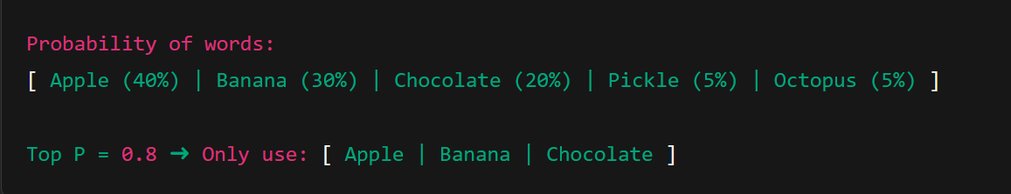
Parameters
Top P (Nucleus Sampling): Limits choices to most likely words.
Low (0.6–0.8): Predictable, formal
High (0.9–1.0): Creative, varied
Frequency Penalty: Reduces repeated words.
Low (0.0–0.5): Allows repetition
High (0.5–1.0): Promotes diversity
Presence Penalty: Discourages repetition of topics.
Low (0.0–0.5): Focused content
High (0.5–1.0): Broad, exploratory
Notes:
Top P Choosing Snacks
Imagine you’re picking a snack from a jar full of treats. Each snack has a different popularity score (how likely people usually pick it):
🍎 Apple (40%)
🍌 Banana (30%)
🍫 Chocolate (20%)
🥒 Pickle (5%)
🐙 Dried Octopus (5%)
If you use Top P = 0.8, you only look at the top snacks that add up to 80% — so Apple, Banana, and Chocolate.
You ignore the strange or rare choices (like Pickle and Octopus), even if they’re available.
Top P tells the AI to focus on the top few most likely words.
Lower = safe and focused; Higher = more creative and surprising.
Would you like me to generate an actual visual image to illustrate this too?

Slide 76
Introduction to GPTs
GPTs (Generative Pre-trained Transformers) are a type of LLMs (Large Language Models) trained to generate outputs (inference) from inputs (prompts) based on their training data (pre-training).
Although GPTs can follow complex instructions, like chatting, answering questions, generating stories, and completing code, they do not possess true intelligence or "understanding" of the inputs and outputs they process.
Some examples of applications using GPTs:
ChatGPT
Google Gemini (formerly known as Bard)
Bing AI (also known as Copilot)
Claude AI Chat
Pi
Grok
Notes:
GPTs don't actually "understand" the inputs and outputs they process; they learn from the training data (using Machine Learning) how to generate outputs from inputs based on patterns and probabilities observed in the training dataGPTs don't retain information they process after the training phase; they "forget" the inputs and outputs after processingGPTs can store the chat history in context while processing tasks, but this is only temporary storage for the current chat/inference session
When the chat/inference session is deleted, the context is lost, and the GPT "forgets" everything it processed
GPTs don't "learn" or "improve" each time they process an inference, regardless of how many times they process similar inputs and outputsHowever, GPTs can be fine-tuned to process specific inputs and outputs after the initial training phase to perform better on specific tasks and/or datasets

Slide 77
How GPTs Work
1. Model Training
GPTs are trained on massive, diverse text datasets to learn patterns and probabilities.
More data and diversity lead to better performance.
Training large models takes weeks or months on powerful hardware.
Models can specialize based on the nature of training data (e.g., medical vs. literary texts).
2. Tokens Encoding & Decoding
GPTs don't work on raw text but on tokens (word pieces or characters).
Text is encoded into tokens, processed, then decoded back into text.
Tokenization supports multiple languages and character sets efficiently.
Notes:
How GPTs Work
Model training
GPTs are pre-trained models that are trained on large and diverse datasets of texts to compute patterns and probabilities between the contents present in the training data
For example, a model trained on terabytes of chemical and biological texts may be able to generate correlations between chemical component names and illness symptoms with much more accuracy and reliability than a model trained on terabytes of literature and poetry texts
Generally, the more data and the more diverse the data, the better the model will be able to generate outputs based on the patterns and probabilities observed in the training data
Current state-of-the-art models are trained on datasets with hundreds of terabytes of texts and other content, and the training process can take weeks or even months to complete even on powerful hardware
The process of training these models involves sophisticated Machine Learning techniques, as we studied in the previous lesson
Tokens encoding and decoding
All calculations in these models are performed on tokens that are encoded and decoded from character strings, rather than on the raw character strings themselves
Each word (or fragment of letters) is broken down into tiny pieces (n-grams) that are used to compute the patterns and probabilities between the contents present in the training data
The encoding process converts character strings into these tokens, and the decoding process converts these tokens back into character strings
This tokenization process allows the model to handle a wide range of languages and character sets efficiently
Transformers
The process of relating tokens to each other in the training data is done by Transformer neural networks, which we saw in the previous lesson
These transformers use self-attention mechanisms to capture complex relationships between different parts of the input data
Transformers are used both in the training phase and in the inference phase of these models to calculate the relations between tokens and generate outputs
Inference
The process of generating outputs from inputs in a transformer is called inference, and can be accomplished much more quickly for prompting than the training phase, since the patterns and probabilities between the contents present in the training data are already computed and stored in the model
For every prompt provided, the model calculates the most probable output based on the model data using various decoding strategies
Since the model doesn't "understand" the concepts of correct or incorrect, meaningful or nonsensical, helpful or toxic, it is up to the person or system passing the prompt to the model to judge the output generated by the model according to their own criteria and standards
Prompting
After the model has been trained, it won't execute anything on its own unless it's prompted to do so
The prompt being passed to the model may vary greatly in format, depending on the task being executed and the model configurations
For example, a prompt for a chatbot may be a question like "What is your name?", while a prompt for a code generator may be a code snippet like "for i in range(10): print(i)"
Most models have certain structures for prompts, allowing for multiple actors to interact inside the model, usually with a "system" actor for answering things that a "user" actor requests from it
The prompt is the input that the model will process to generate the output, and it can be as simple as a single word or as complex as a full book
The prompt is the most important part of the process of generating outputs from inputs, and it can be engineered in many different ways to guide the model to generate more meaningful outputs
Context
GPTs have a limited context maximum length for processing prompts, and they can store the chat history in context while processing tasks, but this is only temporary storage for the current chat/inference session
When passing too much data in a prompt, the model may not be able to process it all correctly, and may even disregard some parts of the prompt or of the training data based on the model configurations and parameters
The context size usually ranges from a few hundred to a few thousand tokens, with some exceptions up to one million tokens context size
This means that the more information you include in the prompt, the less token space the model will have to evaluate the trained data against what is being asked
Managing context effectively is crucial for obtaining accurate and relevant responses from the model
Fine tuning
If GPTs trained on random internet text were not adjusted, they would merely regurgitate random internet texts, giving responses that are completely irrelevant, inaccurate, or even nonsensical
To save space in the context while improving the accuracy of the outputs, the fine tuning process can be used to guide the model to generate more meaningful outputs
In the fine tuning process, the model is trained to prioritize reliable sources and accurate information, reducing the likelihood of generating answers based on misinformation or low-quality internet texts
These processes often include incorporating human feedback to correct errors and biases in the model's responses. This iterative process helps in aligning the model's outputs with human values and expectations
Another common practice is to apply targeted training, which involves fine-tuning the model on a specific dataset that is relevant to the desired application
This targeted approach helps the model learn context and nuances pertinent to particular topics or industries
RAG
The RAG (Retrieval-Augmented Generation) process is a technique that combines a language model's generative abilities with an external information retrieval system
Instead of passing all the context for a question in the prompt, RAG first identifies relevant information from a large database, then incorporates this data into the language model's query
This method significantly improves the model's precision and accuracy, particularly for queries requiring specific information
This is more efficient than passing all the information in the prompt, and is also much simpler than fine-tuning the model with new data
RAG allows models to access up-to-date information without requiring constant retraining, making it particularly useful for applications that need to provide current and accurate information

Slide 78
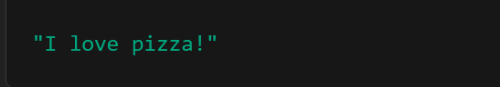
Encoded Tokens:
Depending on the tokenizer (like OpenAI's tiktoken for GPT), the sentence might be split into these tokens:
Token | Text | Token ID (example)
1 | "I" | 40
2 | " love" | 302
3 | " pizza" | 13032
4 | "!" | 0

Slide 79
How GPTs Work
3. Transformers
GPTs use Transformer neural networks with self-attention mechanisms.
Transformers find relationships between tokens during both training and inference.
They are key to understanding context and generating coherent responses.
4. Inference
Inference is generating output from a given input (prompt).
It's faster than training since patterns are already learned.
The model chooses the most probable next word/token.
It doesn’t inherently "understand" meaning—evaluation is up to the user.

Slide 80
How GPTs Work
5. Prompting
GPT only responds when given a prompt.
Prompts vary by use case: e.g., a question for a chatbot, code for a coder.
Prompts often use structured roles like “system” and “user”.
Crafting effective prompts (prompt engineering) greatly affects output quality.
6. Context
GPTs have a limited context window (e.g., thousands to a million tokens).
They temporarily remember chat history but can't retain memory between sessions.
Too much input may cause the model to ignore or misinterpret parts.
Managing context efficiently is essential for relevant answers.

Slide 81
How GPTs Work
7. Fine-Tuning
Without fine-tuning, GPTs may generate irrelevant or poor-quality content.
Fine-tuning aligns the model with reliable sources and specific tasks.
Often includes human feedback to correct biases and improve output.
Can also be targeted, focusing on specific industries or domains.
8. RAG (Retrieval-Augmented Generation)
RAG combines a language model with external data retrieval.
It fetches relevant info from a database before generating the response.
More efficient than adding all data to the prompt or retraining the model.
Useful for keeping responses up-to-date without constant retraining.

Slide 82
Introduction to Prompt Engineering
Specificity: Clearly defining the question or task
Contextual Clues: Providing relevant background information
Direct Instructions: Explicitly stating what type of response is needed
Tone Setting: Indicating the desired style or tone of the response
General recommendations for prompt techniques
Notes:
Importance of prompts
As we've seen in previous lessons, the prompt is a crucial element in controlling the output of Generative AI models
For each desired output, there is a set of corresponding prompts that can be passed to the model to get results in that text region
There's no direct way to know the exact prompts that will generate the desired output, especially when the criteria for "desired" are subjective and dynamic
The only possible way to optimize the prompting process is to iteratively experiment with different prompts and observe the outputs to find the best combination of words in the text space
Different prompts for different models
Each model has its own text space functions and prompting capabilities, so it's common to find prompts that work well for one model but not for another
Some models require specific structures and/or codes to be passed in the prompts to work properly
Some models are designed to be prompted with text to complete, others with image bytes, others with code snippets, others with step-by-step instructions, and so on
Due to this vast variety of requirements, it's almost impossible to find a one-size-fits-all prompt guide
General recommendations for prompt techniques
Specificity: Clearly defining the question or task
Contextual Clues: Providing relevant background information
Direct Instructions: Explicitly stating what type of response is needed
Tone Setting: Indicating the desired style or tone of the response
Other techniques
Phrasing Variations: Experimenting with different ways of phrasing the same question to see which elicits the best response
Example Providing: Giving examples of the expected output
Guided Queries: Asking follow-up questions to narrow down the focus
Role-playing: Asking the AI to assume a specific role or perspective to tailor its responses
Constraints Setting: Specifying any limitations or constraints for the response, such as word count, format, or specific points to include or avoid
Iterative Refinement: Revising and refining the prompt based on the AI's initial response to steer it in the desired direction

Slide 83
Other techniques
Phrasing Variations: Experimenting with different ways of phrasing the same question to see which elicits the best response
Example Providing: Giving examples of the expected output
Guided Queries: Asking follow-up questions to narrow down the focus
Role-playing: Asking the AI to assume a specific role or perspective to tailor its responses
Constraints Setting: Specifying any limitations or constraints for the response, such as word count, format, or specific points to include or avoid
Iterative Refinement: Revising and refining the prompt based on the AI's initial response to steer it in the desired direction

Slide 84

Running LLM Locally
LM studio
https://lmstudio.ai/
GPT4ALL
https://www.nomic.ai/gpt4all
WebUI
https://github.com/open-webui/open-webui

Slide 85
Break

Slide 86
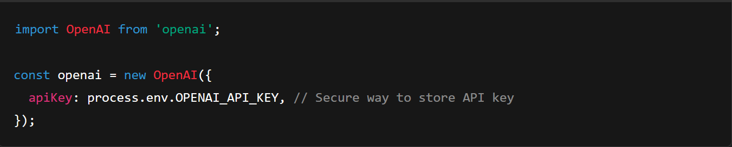
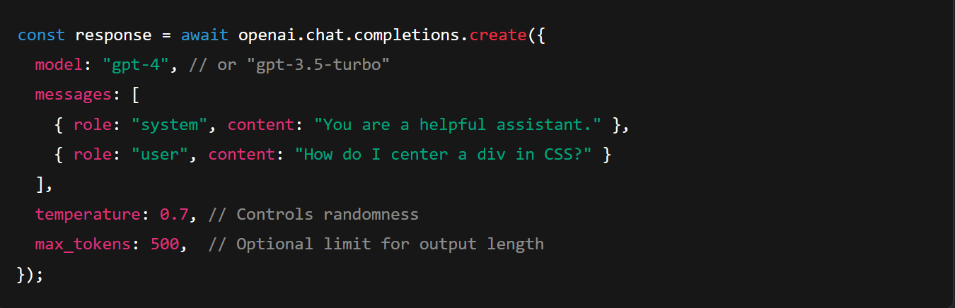
OpenAI chat completion
Notes:
npm install openai
import OpenAI from 'openai';
const openai = new OpenAI({
apiKey: process.env.OPENAI_API_KEY, // Secure way to store API key
});
const response = await openai.chat.completions.create({
model: "gpt-4", // or "gpt-3.5-turbo"
messages: [
{ role: "system", content: "You are a helpful assistant." },
{ role: "user", content: "How do I center a div in CSS?" }
],
temperature: 0.7, // Controls randomness
max_tokens: 500, // Optional limit for output length
});
const reply = response.choices[0].message.content;
console.log("Assistant:", reply);

Slide 87
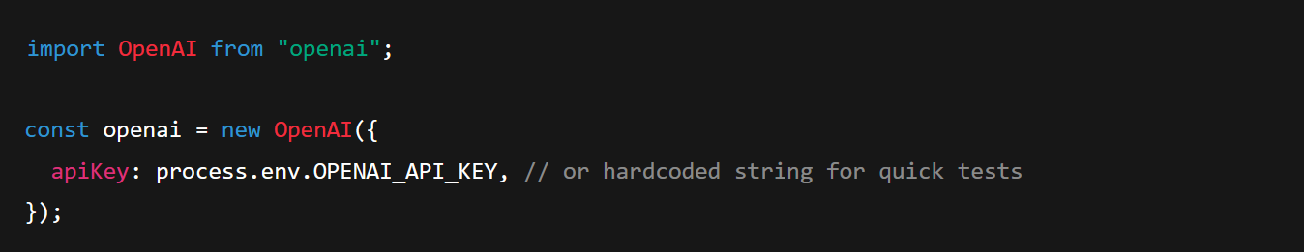

OpenAI Assistants API

Slide 88


OpenAI Assistants API

Slide 89


Gemini API
Notes:
import { GoogleGenerativeAI } from '@google/generative-ai';const genAI = new GoogleGenerativeAI('YOUR_API_KEY');async function chatWithGemini(prompt) { const model = genAI.getGenerativeModel({ model: 'gemini-pro' }); const result = await model.generateContent(prompt); const reply = result.response.text(); console.log("Gemini says:", reply);}chatWithGemini("Summarize the causes of World War I.");

Slide 90
Notes:
import { GoogleGenerativeAI } from '@google/generative-ai';const genAI = new GoogleGenerativeAI('YOUR_API_KEY');async function chatWithGemini(prompt) { const model = genAI.getGenerativeModel({ model: 'gemini-pro' }); const result = await model.generateContent(prompt); const reply = result.response.text(); console.log("Gemini says:", reply);}chatWithGemini("Summarize the causes of World War I.");

